Slide 1
Alaska Slides
Kodiak West Travel

Slide 2
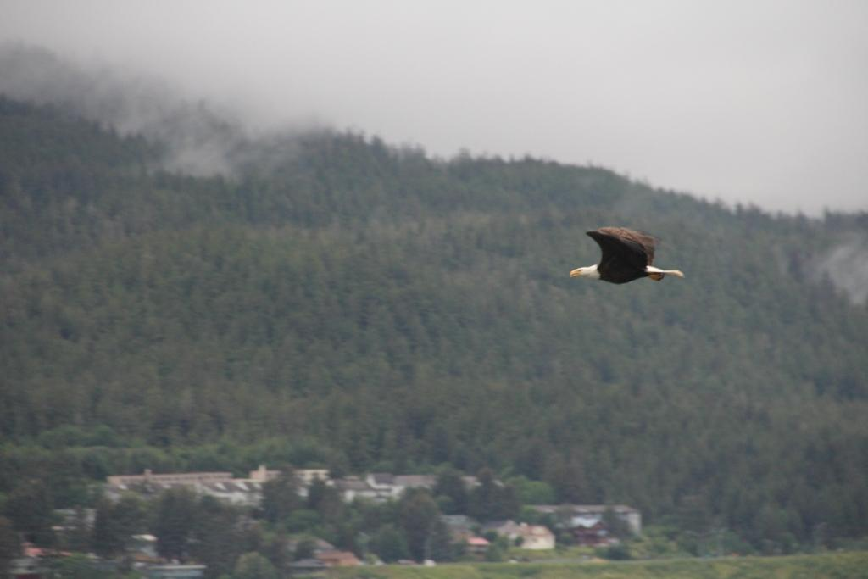
Lights, Camera, Action
Be prepared at all times with your camera. You will want to be ready if nature decides to fly right by you.

Slide 3
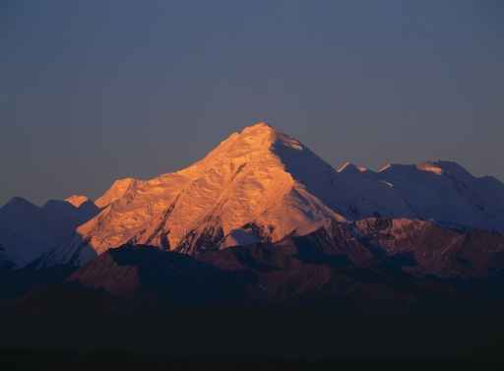
Brooks Mountain Range
A treeless range peppered with rivers and streams and home to a variety of birds and land and marine mammals.

Slide 4
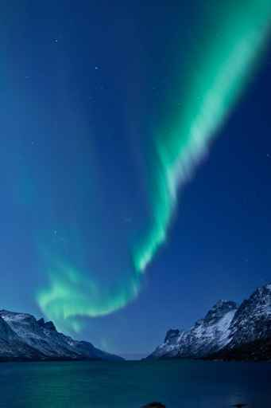
The Aurora Borealis
Ribbons of blue, green, pink, and purple luminescence that are caused by the collisions of electrically charged particles in the atmosphere.

Slide 5
Viewing the Lights from Fairbanks
Cleary Summit
Chena Lakes Recreation Area
Steese Highway
Ester Dome

